Slide 1
Fracking Fraccidents
Will, Keegan, Dillon, Jonathan, and Ryan

Slide 2
Our Question
How do injection wells, fracking wells relate to earthquakes?
Is there a direct link between the two, do the wells directly cause earthquakes?
Specifically focusing on mid-west area
Motivation: At a glance there appears to be a strong correlation between the number of injection wells and earthquakes, despite many in the general public not knowing of these correlations.
Goal: Overlay both location and date data for well data and earthquake epicenters date.
Notes:
Notes about Motivation: The number of wells has increased by twice as many in the midwest, and the number of earthquakes has increased exponentially in the same time period.

Slide 3
History of Fracking
Developed to allow wells to produce more oil or gas
Origins: 1865
The “Exploding Torpedo”
Became commercialized in 1949
Closer technique to modern day technique (No bombs)
Modern Fracking began in the 1990s
Combines hydraulic fracturing and Horizontal drilling
The Shale boom in 2010 dramatically increased America’s oil production and interest in Fracking
Due to an increase of oil prices
Notes:
Ryan
http://oilprice.com/Energy/Crude-Oil/The-Real-History-Of-Fracking.html

Slide 4
Earthquakes and Fracking
Injection wells/fracking have already been linked to earthquakes.
The U.S. Geological Survey: injection wells are much more likely to produce earthquakes than fracking wells.
Scientists have found that the increase in earthquakes is linked to fluid injection wells
wells with higher rate of injection → more likely to cause earthquakes
Notes:
Ryan
Will

Slide 5
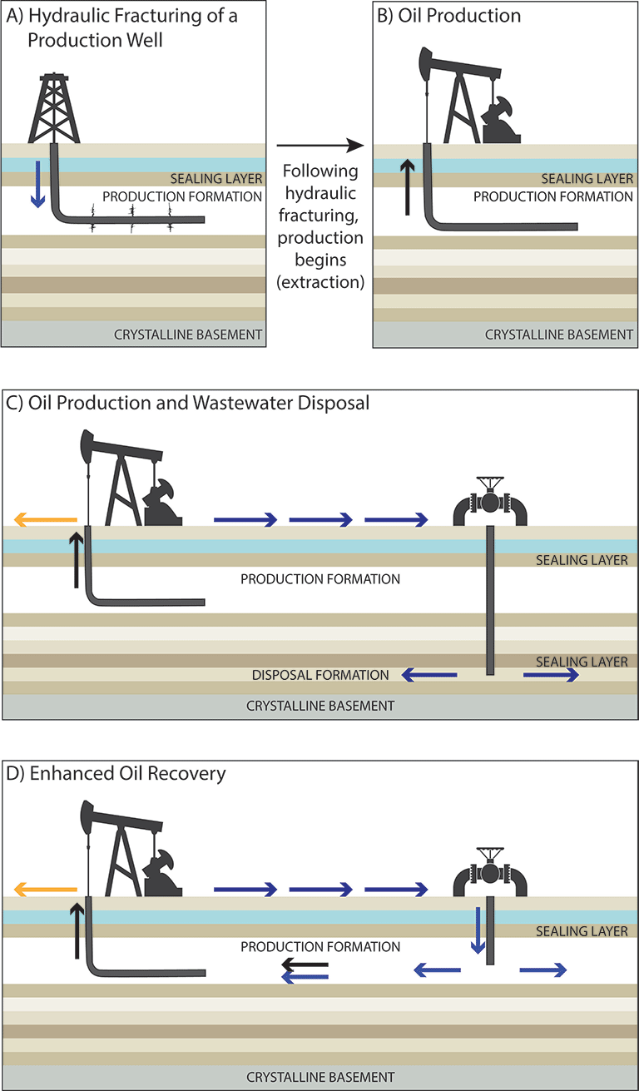
Earthquakes & Fracking
Seismicity can be induced up to 10 miles from the source of the injection
These injection wells may include only some portion of fracking fluid
Includes saltwater also resulting from fracking
Injection occurs deeper and may trigger the fault, leading to induced earthquakes

Slide 6
Things To Know
Mohr-Coulomb theory describes the reaction of materials to stress.
Is used to estimate the amount of stress(bars) required to cause induced earthquakes
A bar is equivalent to 14.5 pounds of force per square inch (Psi)

Slide 7
Rocky Mountain Arsenal, Denver, Colorado
An Injection well created in 1961 to store wastewater from oil production
Caused a series of earthquakes in an area where the last recorded earthquake was in 1882
A total of 620 million liters of fluid were injected
3 major earthquakes of magnitude greater than 5 cause some structural damage and had an epicenter at or near the bottom of the injection well

Slide 8
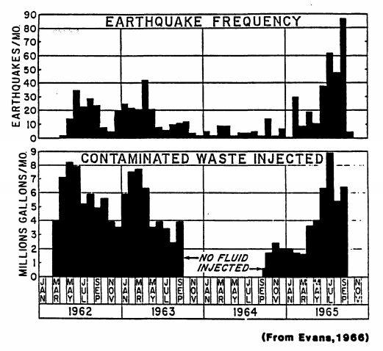

Slide 9
Rangely, Colorado
Waterflooding, a process of injection water to increase pressure causing more oil to be pushed through a collection pipe.
A total of 9100 million liters of water were injected which caused a total of 2,300 million liters of fluid to be added to the system.
A network of seismological stations and equipment was set up in 1929 to determine the location and cause of the series of earthquakes.
Notes:
A series of test were done that increased and decreased fluid pressure in the area. Results concluded that increased pressure increased seismicity and decreased pressure nullified earthquakes.

Slide 10
Attica-Dale, New York
Solution Mining, triggered increase in seismicity
As many as 80 microearthquakes a day, between -1 and 1 magnitudes
Pressure at the top of the well typically operated at 55 bars which is only a few less than the Mohr-Coulomb projections
After the end of the solution mining, seismicity drastically fell

Slide 11
Data
Wells
Location
State, latitude, longitude
Type
Injection, gas, oil, brine disposal, etc.
Spud Date
Initial drilling date
Earthquakes
Date
Location
Latitude, longitude
Magnitude
Intensity on Richter scale
Notes:
Ryan V- for well data
Keegan- earthquake part

Slide 12
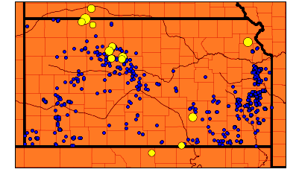
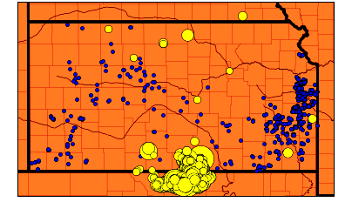
What does the data show?
Double the wells, a quarter the time
From 2000-2012 there were almost 1600
From 2013-2015 there were 3099
Earthquakes increase hundredfold
From 2000-2012 there were 16
From 2013-2015 there were over 1600
2000-2012
2013-2015
Notes:
Poopsy

Slide 13
What else does the data show?
More and more earthquakes
2000-2012
16 earthquakes
2013
22 earthquakes
2014
596 earthquakes
2015
1019 earthquakes

Slide 14
Next Steps
Access to the privatized wells data for Texas and similar states
Gather wells data for every state
Gather more earthquakes data for the entire United States
map out earthquakes alongside the new wells data

Slide 15
Next Steps cont.
Water quality data that includes chemical byproducts of fracking such as toluene and ethylbenzene.
Finding the data on instances of fracking accidents, or “fraccidents”

Slide 16
Works Cited
http://www.cbc.ca/natureofthings/content/images/episodes/wolverines_1920.jpg
http://oilprice.com/Energy/Crude-Oil/The-Real-History-Of-Fracking.html
https://earthquake.usgs.gov/research/induced/myths.php
https://pubs.usgs.gov/of/1987/0331/report.pdf
https://scits.stanford.edu/sites/default/files/evans_0.pdf
http://science.sciencemag.org/content/348/6241/1336

